Slide 1
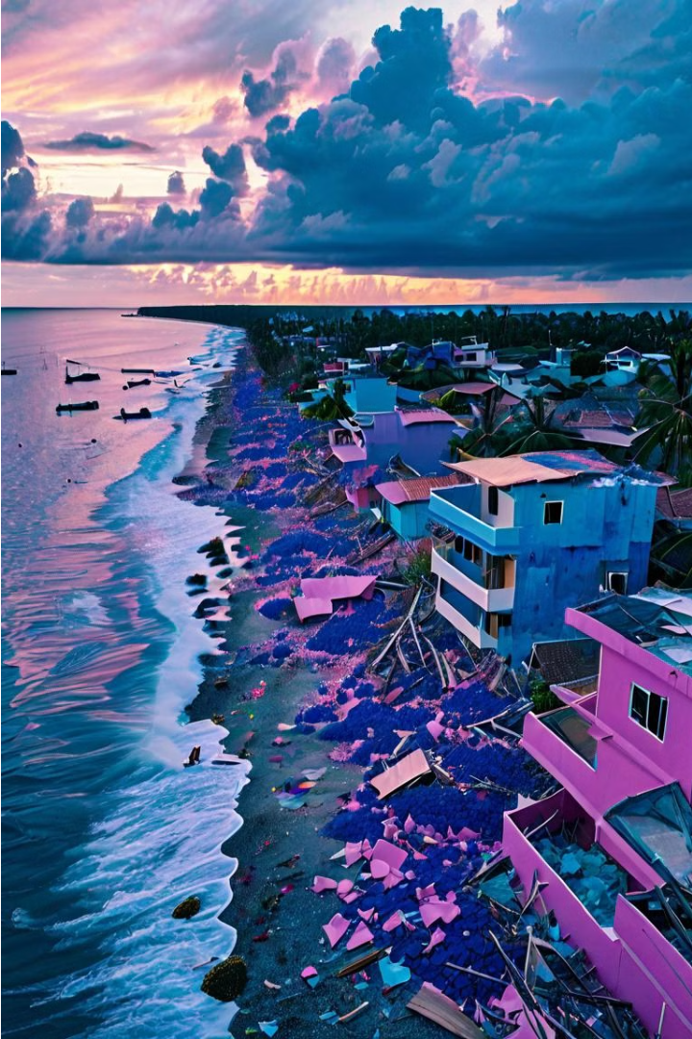
Detecting Humans in Tsunami Debris
Using Custom Vision for Real-Time Detection
By Nithish Nuthalapati
Harish Reddy kadukuntla
Yeshwanth Reddy Peddola
Bhanu Chander Mudeli

Slide 2

Problem Statement
Rescue teams face challenges locating survivors in tsunami debris, delaying critical rescue efforts. This project aims to use image recognition to quickly identify human presence, improving speed and safety of rescue operations.
1
Time-Consuming Manual Search
2
Need for Faster Detection
3
Improve Rescue Efficiency
The manual process is labor-intensive, putting lives at risk.
Rapid identification of survivors can save lives.
Precise locations enable quicker and safer rescue efforts.

Slide 3
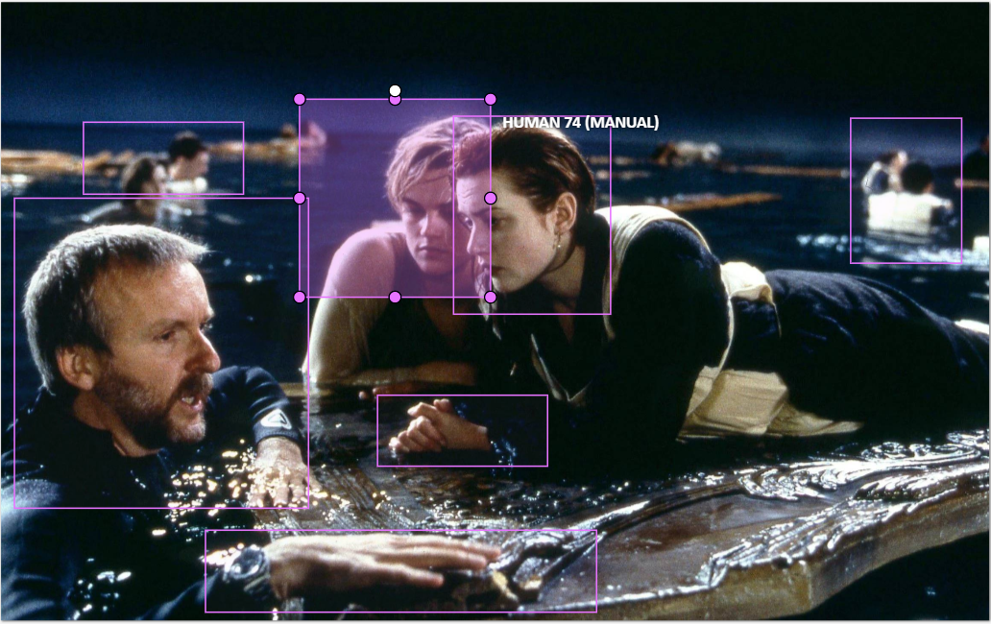
Project Overview
This project uses image recognition to detect humans in tsunami debris, aiding rescue teams in swiftly identifying trapped or stranded individuals.
1
Identify Survivors
Rapid human detection is critical for effective rescue operations.
2
Enhance Safety
Quick and accurate identification can save lives for victims and rescuers.
3
Improve Efficiency
Precise locations enable quicker and more efficient rescue efforts.

Slide 4
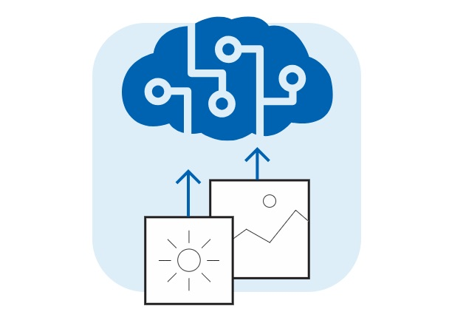
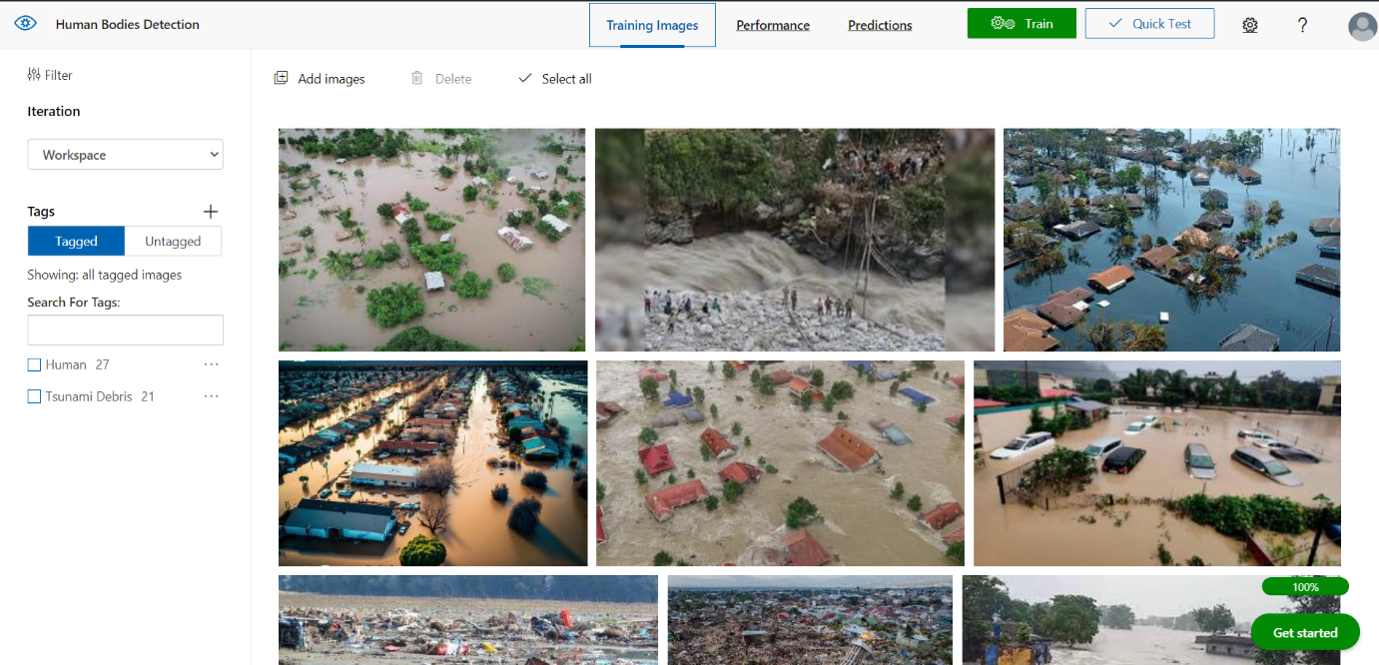
Custom Vision Overview
Custom Vision is a cloud-based image recognition service that uses machine learning to classify and detect objects in images, enabling the identification of humans in tsunami debris.
How it Works
Advantages
Key Features
Machine learning algorithms analyze and learn from a set of labelled images to classify new images and identify the presence and location of specific objects or features.
Rapid processing, high accuracy, adaptability, and user-friendly integration make Custom Vision a valuable tool for this project.
Speed, precision, and versatility in diverse environments and conditions.

Slide 5
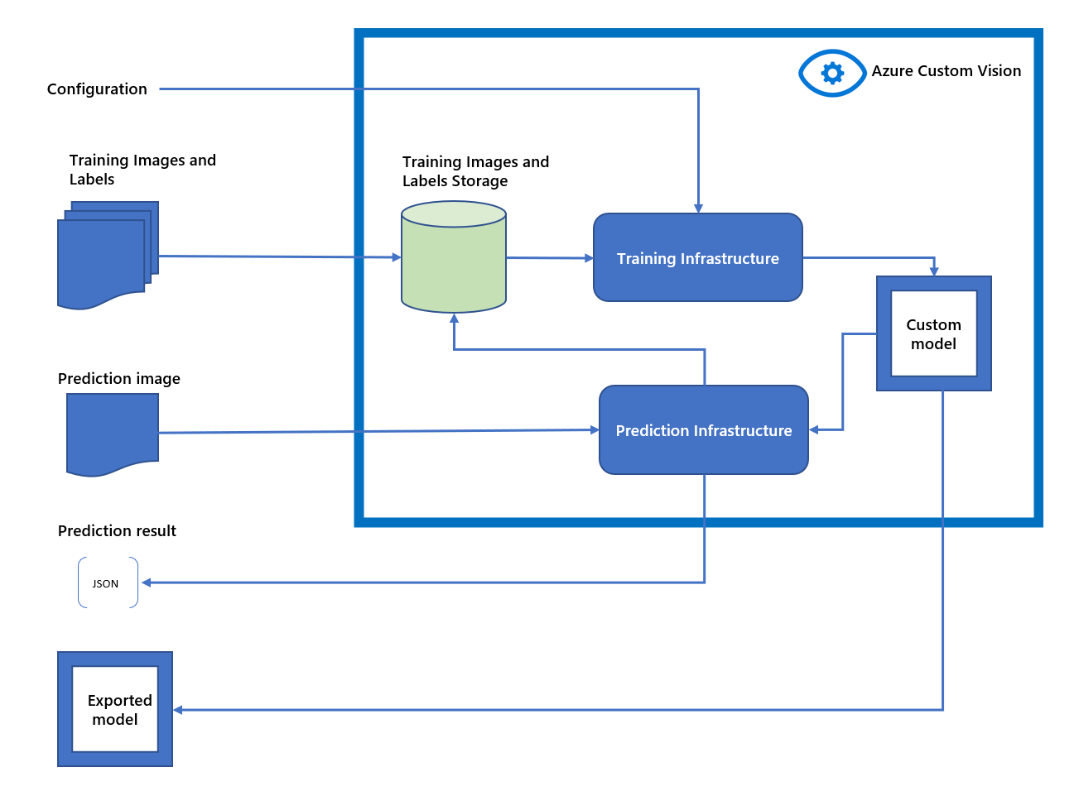



Methodology
The project involves collecting diverse data, training the Custom Vision model, and validating its performance to optimize human detection in tsunami debris.
Data Collection
Gather images from various sources, including aerial, ground-level, and drone footage.
https://qz.com/1408467/the-indonesia-tsunamis-aftermath-in-photos
Data Preprocessing
Clean, annotate, and balance the dataset to ensure model robustness.
Model Training
Use labelled images to train the Custom Vision model to identify human patterns.

Slide 6
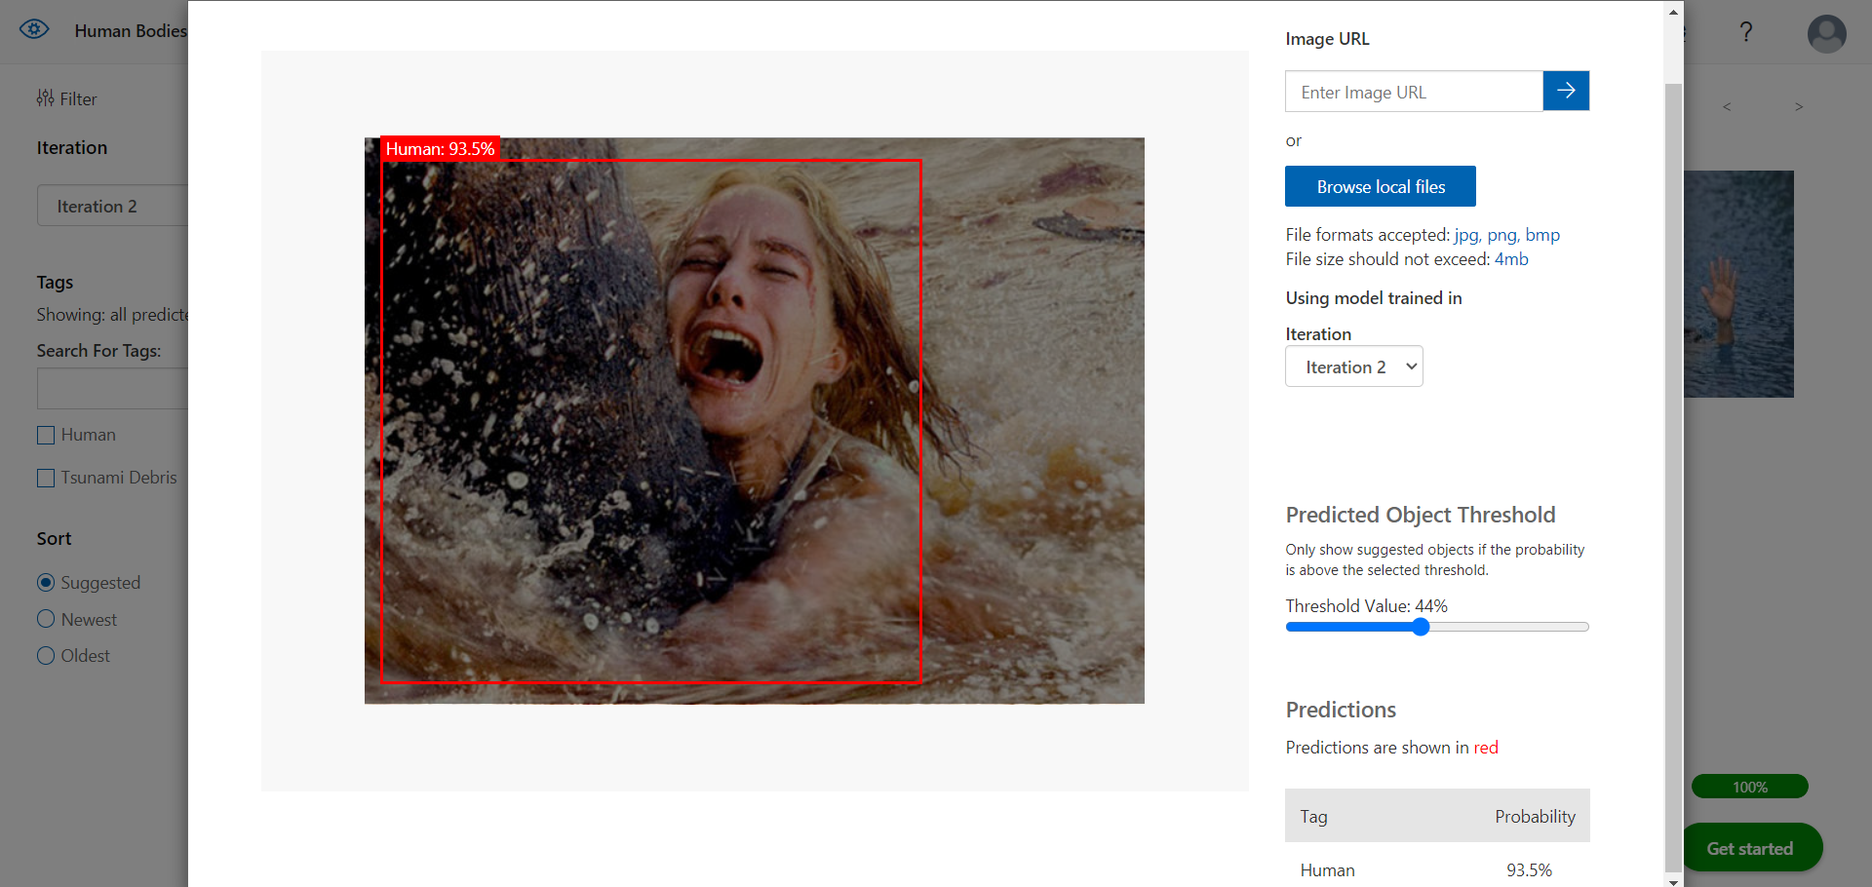
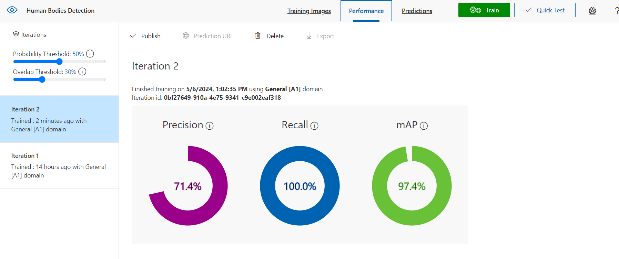



Results
The Custom Vision model achieved high accuracy in detecting humans within tsunami debris, demonstrating its effectiveness in supporting rescue operations.
Precision
Recall
mAP
71.4% - Avoiding false positives
100% - Capturing all relevant instances
97.4% - Consistent high accuracy

Slide 7
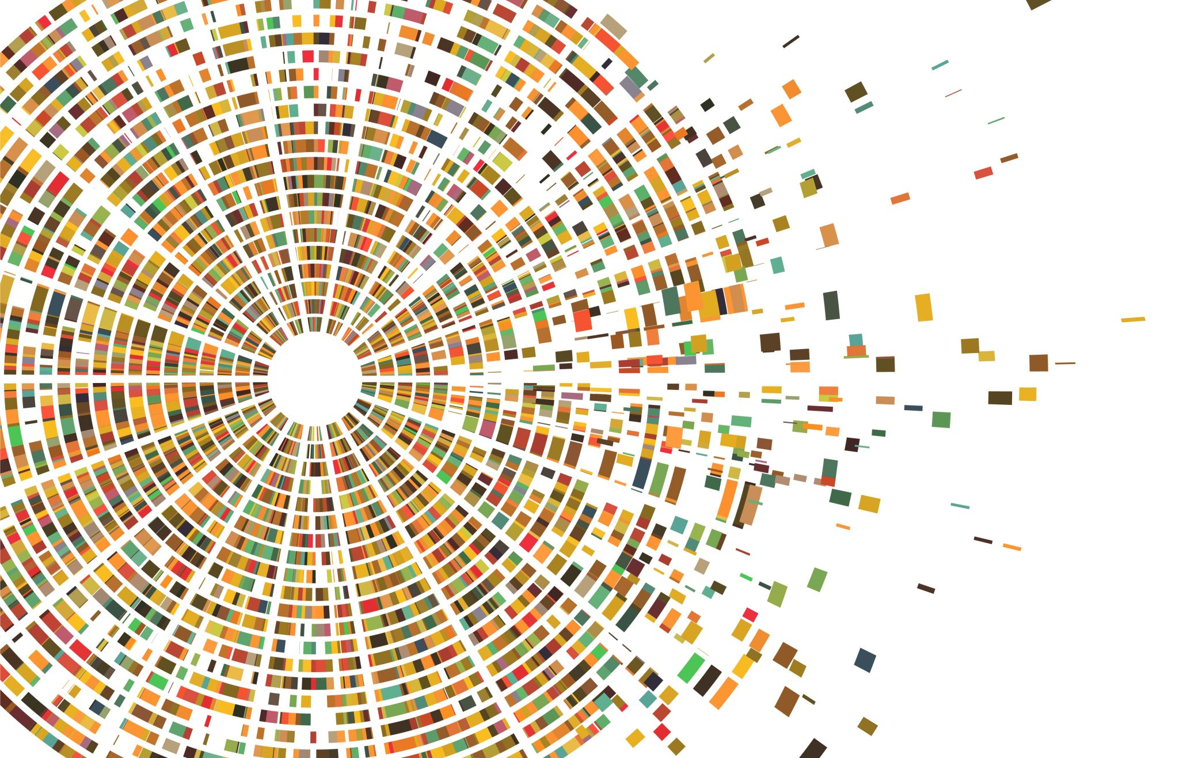
THANK YOU

